Slide 1

Capstone Option 2: Biodiversity for the National Parks
Craig Smith – Data Analysis course through Codecademy
October 23/18 to January 22/19

Slide 2
my TASK:
Analyze data on endangered species from several different parks, specifically, on the conservation statuses of these species.
Investigate if there are any patterns or themes to the types of species that become endangered.
Present any findings to the National Park Service

Slide 3
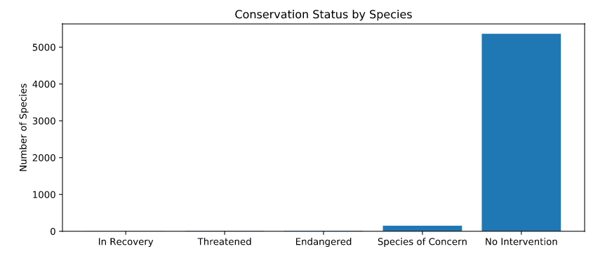
Breaking Down the Data
In total, 5541 species were recorded, categorized into 7 unique species types:
MAMMAL, BIRD, REPTILE, AMPHIBIAN, FISH, VASCULAR PLANT, NONVASCULAR PLANT
Of these 5541 species, 5 conservation statuses were given:
SPECIES OF CONCERN, ENDANGERED, THREATENED, IN RECOVERY and NO INTERVENTION
Of the 5 conservation statuses:
5341 are listed as “NO INTERVENTION” (~ 96.4%)
4 are listed as “IN RECOVERY” (< 0.1%)
151 are listed as “SPECIES OF CONCERN” (~ 2.7%)
10 are listed as “THREATENED” (~ 0.2%)
15 are listed as “ENDANGERED” (~ 0.27%)

Slide 4
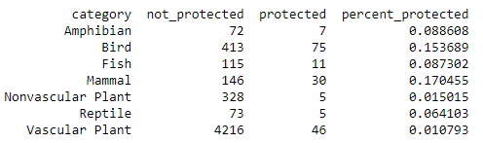
Are certain types of species more likely to be ENDANGERED?
Of the species broken down into category, both birds and mammals had the highest percentage of needing protection (not listed as “No Intervention”), with 17% of mammals under protection and 15% of birds.
CHI SQUARED TEST (significant difference)
The difference in endangered birds and mammals was found to be due to chance.
The difference in endangered reptiles and mammals was not found to be due to chance.
It would be recommended to conservationists that birds and mammals are more likely to be endangered than other types of species.

Slide 5
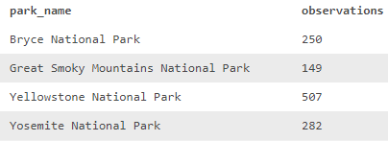
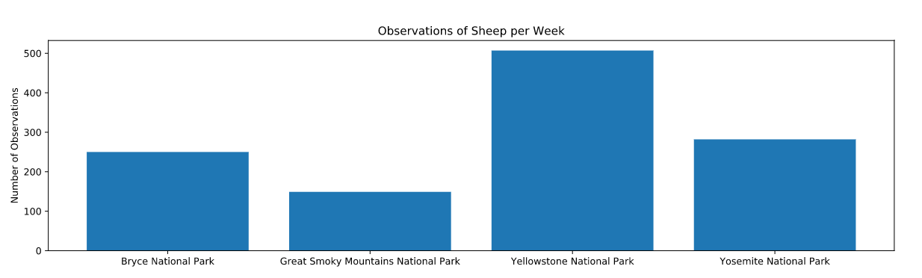
Conservationists Data: Foot and Mouth Disease
Conservationist data (‘observations.csv’) was used in combination with the previous data (‘species.csv’) to show how many sheep sightings there had been at each of four national parks under investigation.
In an effort to reduce the amount of foot and mouth disease, a sample size calculator was used by scientists to determine that with:
A baseline of 15% of sheep having the disease
A min. detectable effect of 5%
A sample size of 870 sheep needed and
A statistical significant of 90%
It would take nearly 2 weeks (1.7) of observation to observe enough sheep at Yellowstone National Park and nearly 3.5 weeks (3.47) to observe enough sheep at Bryce National Park.

Slide 6
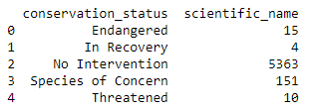
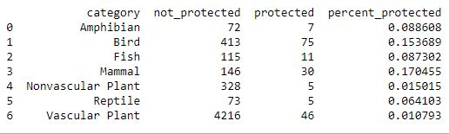
Charts and Reports – Protected Species
Conservation Count
Total Protected Species Count

Slide 7
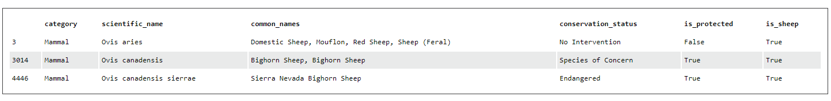
Charts and Reports – Foot and Mouth Disease
scientific_name | park_name | observations | category | common_names | conservation_status | is_protected | is_sheep
Ovis canadensis | Yellowstone National Park | 219 | Mammal | Bighorn Sheep, Bighorn Sheep | Species of Concern | True | True
Ovis canadensis | Bryce National Park | 109 | Mammal | Bighorn Sheep, Bighorn Sheep | Species of Concern | True | True
Ovis canadensis | Yosemite National Park | 117 | Mammal | Bighorn Sheep, Bighorn Sheep | Species of Concern | True | True
Ovis canadensis | Great Smoky Mountains National Park | 48 | Mammal | Bighorn Sheep, Bighorn Sheep | Species of Concern | True | True
Ovis canadensis sierrae | Yellowstone National Park | 67 | Mammal | Sierra Nevada Bighorn Sheep | Endangered | True | True
Ovis canadensis sierrae | Yosemite National Park | 39 | Mammal | Sierra Nevada Bighorn Sheep | Endangered | True | True
Ovis canadensis sierrae | Bryce National Park | 22 | Mammal | Sierra Nevada Bighorn Sheep | Endangered | True | True
Ovis canadensis sierrae | Great Smoky Mountains National Park | 25 | Mammal | Sierra Nevada Bighorn Sheep | Endangered | True | True
Ovis aries | Yosemite National Park | 126 | Mammal | Domestic Sheep, Mouflon, Red Sheep, Sheep (Feral) | No Intervention | False | True
Ovis aries | Great Smoky Mountains National Park | 76 | Mammal | Domestic Sheep, Mouflon, Red Sheep, Sheep (Feral) | No Intervention | False | True
Ovis aries | Bryce National Park | 119 | Mammal | Domestic Sheep, Mouflon, Red Sheep, Sheep (Feral) | No Intervention | False | True
Ovis aries | Yellowstone National Park | 221 | Mammal | Domestic Sheep, Mouflon, Red Sheep, Sheep (Feral) | No Intervention | False | True

